Slide 1
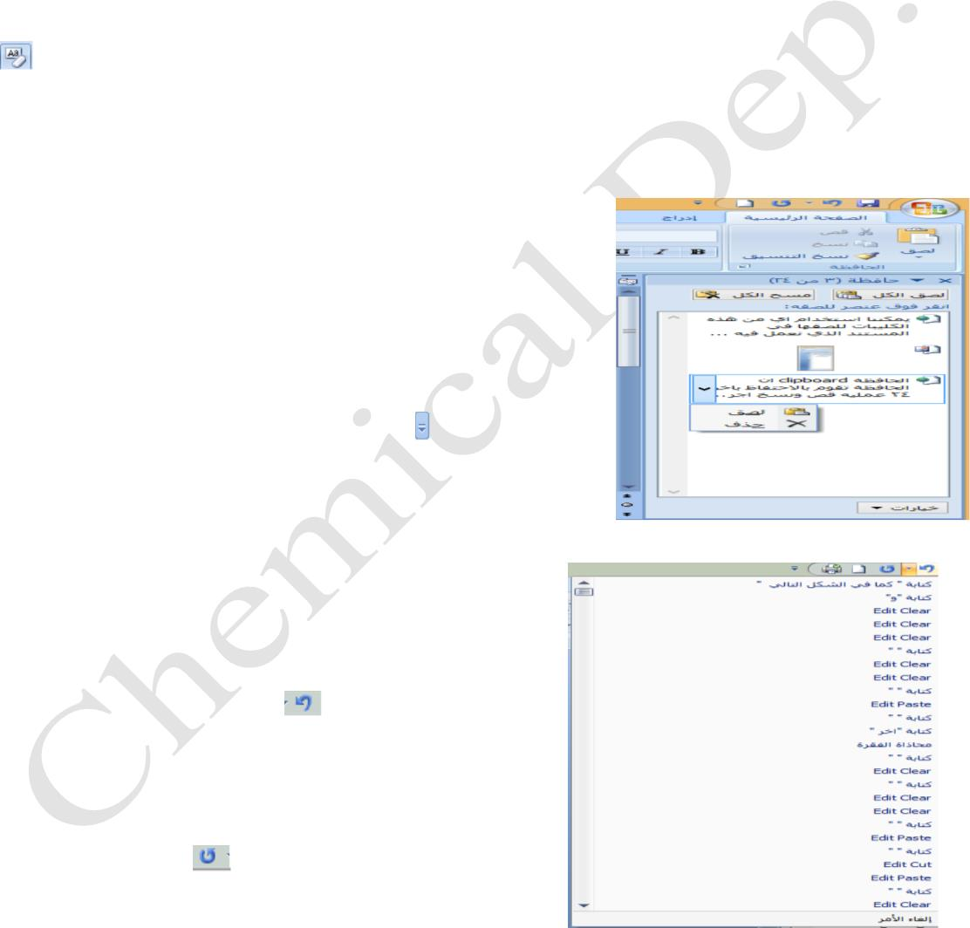
Lecturer
Omar Imran
2019 - 2020
oft office Word 2007
Diyala university/College of Engineering
Department of Chemical Engineering
Format painter
We can apply formatting to specific text in the text of the latest document to make any formatted text
format is similar to the first color, shape, size and other formats To do so follow these steps: -
. Select the text you want to copy formatted
.
.
.
Select and copy it to the clipboard coordination
now define the text you want to apply formatting to click it, and it
Coordination will apply it directly
Clear Formatting
We can scan text formatting text without making any formats To do so follow these steps: -
.
.
.
Select the text you want to format scanning
Select it and coordinate survey of "Home Tab" within the group "line"
Coordination will apply it directly
Office clipboard
Are preservatives that keep the process ČĂÎŃ 24 cut, copy you made
recently When clicking on the arrow in the portfolio within the Home
tab you'll see the last of cut, copy, and you made that we can restore it
or make any process them as in the following figure
.
to paste all the contents of the Clipboard, select
Paste All command
to clear all the contents of the clipboard, choose
Clear All command
Trail Version
Trail Version
Trail Version
Trail Version
Trail Version
Trail Version
Trail Version
Trail Version
Trail Version
Trail Version
Trail Version
Trail Version
Trail Version
.
.
When you click on the button next to the contents
of the clipboard show a drop-down list (delete, paste), where
one can scan the contents of the clipboard or paste it by
clicking on one of them. As in Fig.
Undo and replay (repetition)
We can undo the last 100 and finished the process as
follows:
• clicking the undo button
is undo the last you've
made, and clicking on it once again be rolled back
for the second operation, and so on until the last
process you've made recently, and vice versa can
restore operations that retreat by clicking on the
button replays
was undone .
and every time it is re-last labor
•
We can undo and replay it by clicking on the arrow
between the two buttons undone and repatriation and choose any process of irreversible or
choose All as in Fig.
First Class
11

Slide 2
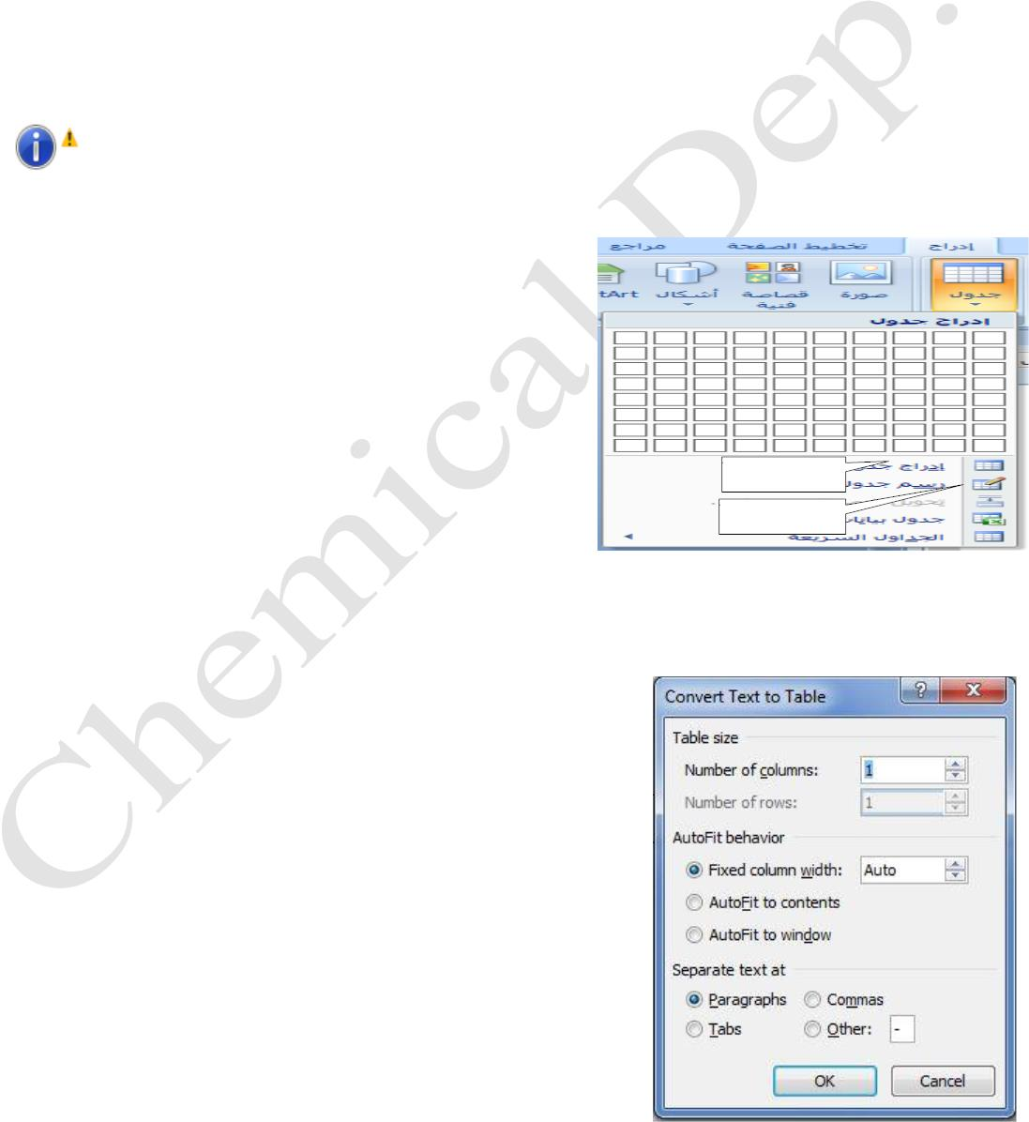
Lecturer
Omar Imran
2019 - 2020
oft office Word 2007
Diyala university/College of Engineering
Department of Chemical Engineering
Bullets and digital
We can work bulleted or numbered paragraph or any text put any points or numbers before the
beginning of the paragraph as follows: -
•
Select the text you want to make a bulleted or numbered him
• Choose it bulleted or numbered paragraph of the section within the Home Tab
• Choose any type of bullet or digital you have in your window options and carried out by
clicking on the OK
•
When the continuation of the writing process will continue after each census are pressuring
enter a new paragraph before every census there will be to remove it you can click on the enter
again will be removed from the census also new paragraphs.
Hint
: - You can make a bulleted manner instead of the symbol and the choice of the same bullet
Choose it (determining the Bullets new) and then select the image or icon you'll see a dialogue window
where the number of images or image Choose the appropriate
icon and click OK to be applied.
Tables
We can insert a table of the document as follows:
Trail Version
Trail Version
Trail Version
Trail Version
Trail Version
Trail Version
Trail Version
Trail Version
Trail Version
Trail Version
Trail Version
Trail Version
Trail Version
• Insert tab of the CHANGE command table will open a
•
dialogue window as shown in Figure.
Insert Table
Draw Table
Select from which the number of lines and the number of
columns you want for the table and then click OK will
create a table in your document, you can fill in the table
with information and text and numbers that you want to easily within the same document.
You can draw a table from which and by clicking on it to draw the table as in the figure above, and we
set the number of lines and the number of columns and by moving the cursor on the table in the
window.
•
Convert Text to Table
You can convert specific text in a document to a table as
follows:
•
•
•
•
•
Select the text you want to convert to a table
inclusion of Tab
Choose the command table
Choose it and then convert the text to table
dialogue window will appear as in Figure
Select from which the number of columns , as well as select
First Class
12

Slide 3
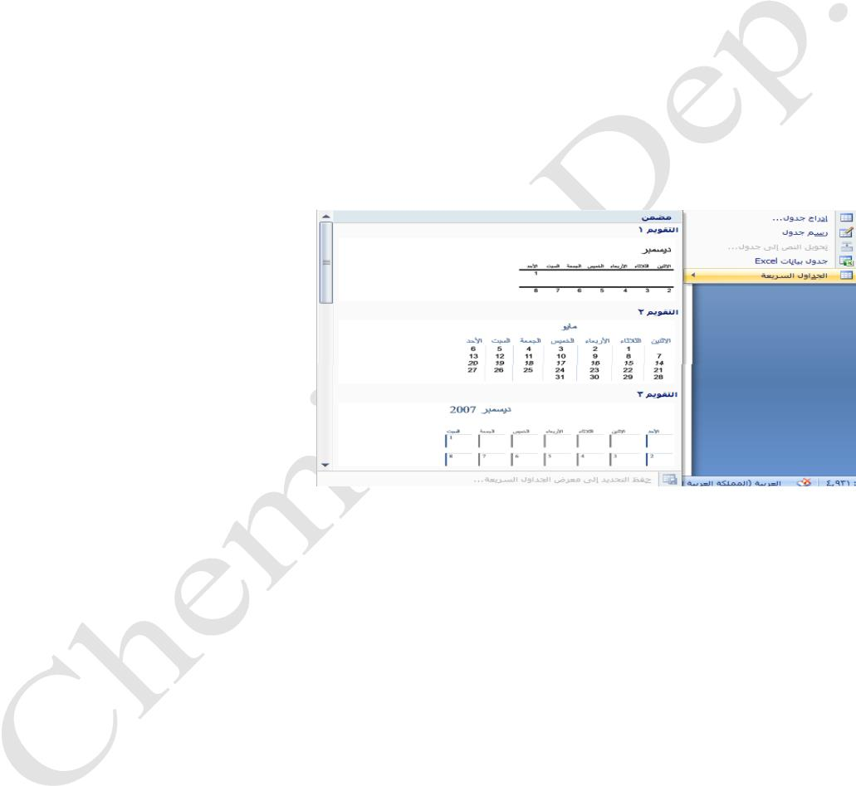
Lecturer
Omar Imran
2019 - 2020
oft office Word 2007
Diyala university/College of Engineering
Department of Chemical Engineering
separate text at the end of paragraph
After completing Click OK will create a table containing the text you selected paragraphs
Of the document
•
insert tables fast
•
•
•
There are some ready-made tables that can be inserted quickly and easily to any document
inclusion of Tab
Choose the command table
then select the command tables fast appears a window there in the window several models
ready for the tables , we can choose any of them by clicking on it will be incorporated directly
into the document, now we can make any adjustments to it as a change of values or texts or even
formats after the completion click on any vacuum in the document to be installed table as in the
following figure .
Trail Version
Trail Version
Trail Version
Trail Version
Trail Version
Trail Version
Trail Version
Trail Version
Trail Version
Trail Version
Trail Version
Trail Version
Trail Version
Page Layout
• margins Page
Margin : the empty space outside the printable area of each page in the document , we can
determine the page margins of the upper and lower views and aspects of Yemen , left, as
follows
•
•
•
of Tab " page layout " and the group " Page Setup "
pick up margins
will show us the Options window and choose which type of margin that we want to
identify Distance margin as if the narrow or broad or Aadda or inverse mirror as we can
pick it up margins dedicated and determine the value of the top margin and the bottom as
well as right and left .
First Class
13

Slide 4
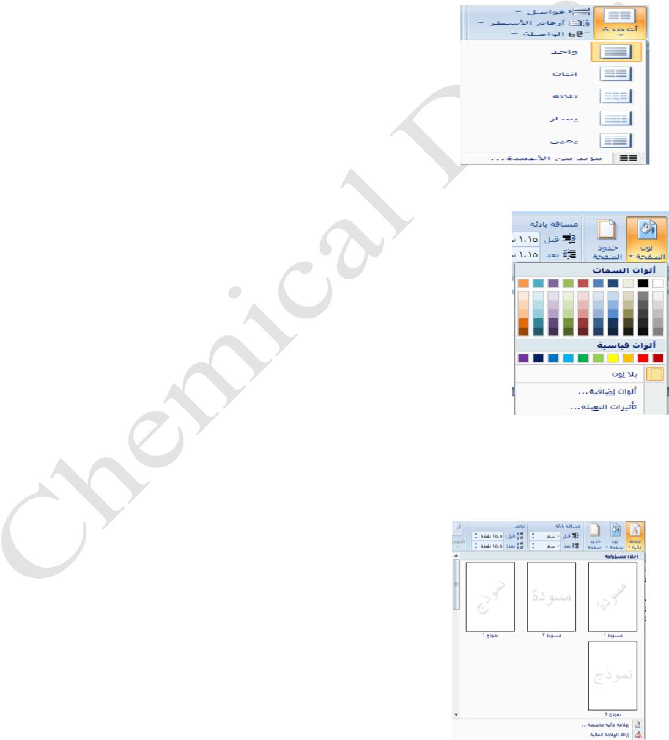
Lecturer
Omar Imran
2019 - 2020
oft office Word 2007
Diyala university/College of Engineering
Department of Chemical Engineering
• page orientation
To prepare a trend page document , follow these steps : -
• From the Page Layout tab
• Click on Page Setup and choose the direction it
• If you want to select a vertical or horizontal direction
• set up columns
We can make the text in the document in the form of columns
which made him a pole and one or more To do so, follow these
steps
•
•
•
From the Page Layout tab
Click on Page Setup, then select the columns it
window will appear, select choices from which the
number of columns you want to make the text in the
document, it seems as in Fig.
•
You can check through the "More columns" Post an
columns and determine the number and type of columns you want to make the text and it
seems that from the window of the options that will appear to you.
• Background Page
You can use gradients, or patterns, or images, or solid colors, or materials
for Alkhlviat.olngar background document, follow these steps: -
Trail Version
Trail Version
Trail Version
Trail Version
Trail Version
Trail Version
Trail Version
Trail Version
Trail Version
Trail Version
Trail Version
Trail Version
Trail Version
•
•
In the Page Layout tab, in the Page Background group, click Page
Color.
Do one of the following:
• click the color that you want within the colors or features standard
•
colors.
click Fill Effects to change or add special effects, such as
gradients, materials or inscriptions, as in the following figure,
• Remove background
• In the Page Layout tab, in the Page Background group, click Page Color.
• click None color as in Fig.
• Add watermark
Watermarks is a text or images appear behind the text of the
document. They often add suspense element or know the status of the
document, such as marked on the document , such as a draft . You can
see the watermarks in view " Print Layout " view and " read in full
screen mode " or in a printed document .
In the Page Layout tab , in the Page Background group , click
Watermark .
First Class
14

Slide 5
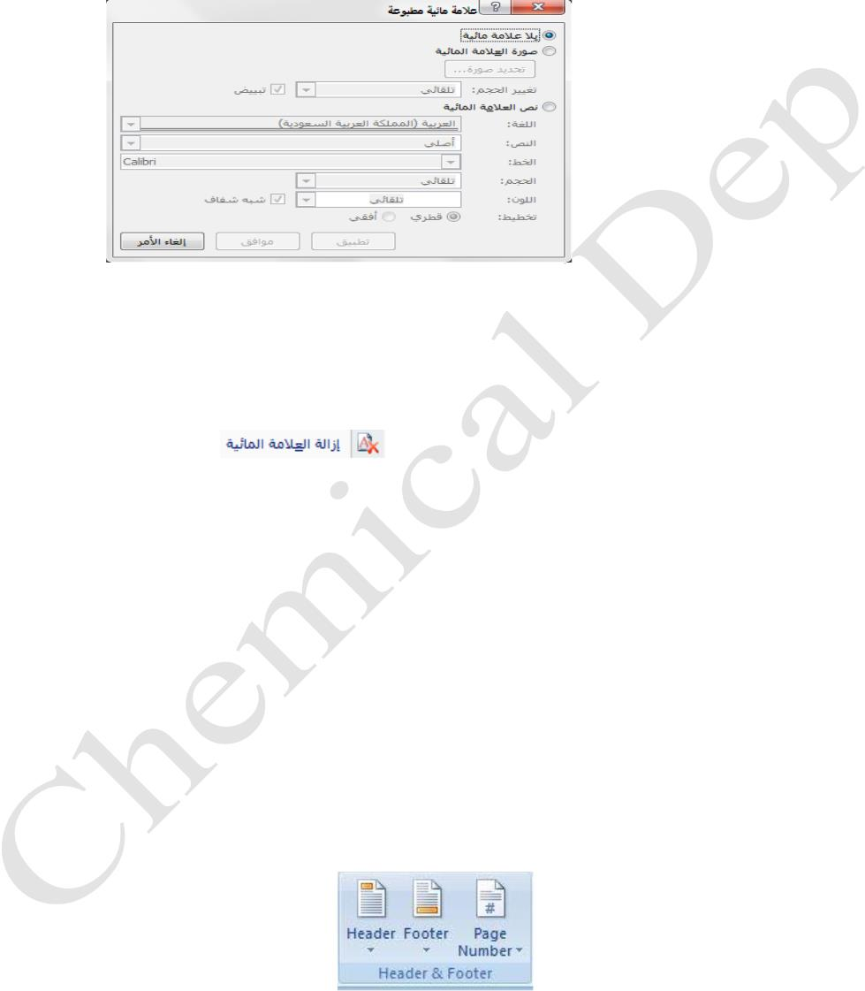
Lecturer
Omar Imran
2019 - 2020
oft office Word 2007
Diyala university/College of Engineering
Department of Chemical Engineering
• Do one of the following:
• Click the watermark was designed in advance , such as Sri urgent or watermarks in the gallery ,
as in Fig .
• click a custom watermark , click Text watermark , then select the text as shown in Figure below
• Remove the watermark
Do one of the following:
1- in the Page Layout tab, in the Page Background group, click Watermark.
Trail Version
Trail Version
Trail Version
Trail Version
Trail Version
Trail Version
Trail Version
Trail Version
Trail Version
Trail Version
Trail Version
Trail Version
Trail Version
Click Remove Watermark
Insert headers and footers
Headers and footers are ways and upper and lower side of the margins on Cefhh.amkink insert text or
graphics or change in headers and footers. For example, you can add page numbers or the time and
date or a company logo or title of the document or file name or the name of the writer.
• insert headers and footers
• On the Insert tab
• in the group header and footer, click the header or footer. As in Fig.
• menu appears designs design click the header or footer that you want. Is inserted header or
footer on each page of the document. Then you can insert text or graphics or change.
First Class
15

